Slide 1

Air Fare prediction
GROUP 5

Slide 2
Business objective & Acceptance criteria:
Air Fare prediction
To predict airfare, as travel is popular these days, with different air ticket booking channels, travellers are trying to make sense and understand how airlines price their tickets over time.
We want to explore previous airfare data and build a model to predict the price fluctuations over time so that the consumer could benefit from it.
We want to identify dependency over many endogenous variables.
Should get the least possible RMSE and the model should be deployed using Flask/ Rshiny/Heroku.

Slide 3


Data set details
Air Fare Prediction
The data set contains 4 variables:
Invoice Date
Net Fare
Product Type and
Itinerary Type
There are 2,78,466 records.

Slide 4
FORECASTING STRATERGY

Slide 5
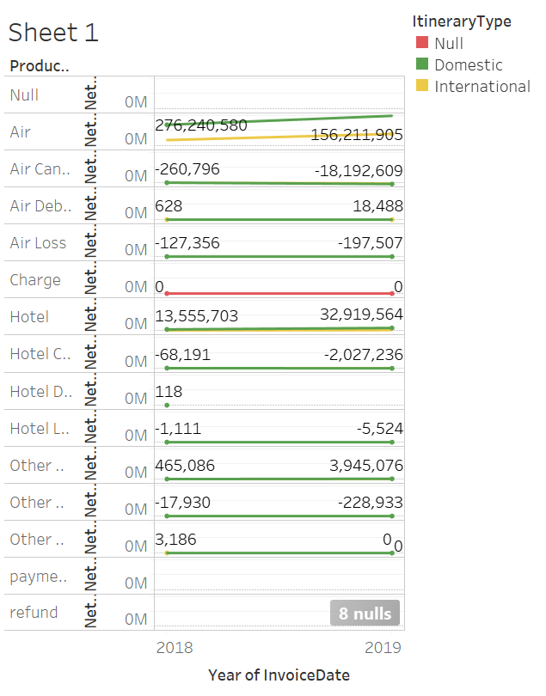
EXPLORATORY DATA ANALYSIS
Data distribution with NA’s

Slide 6
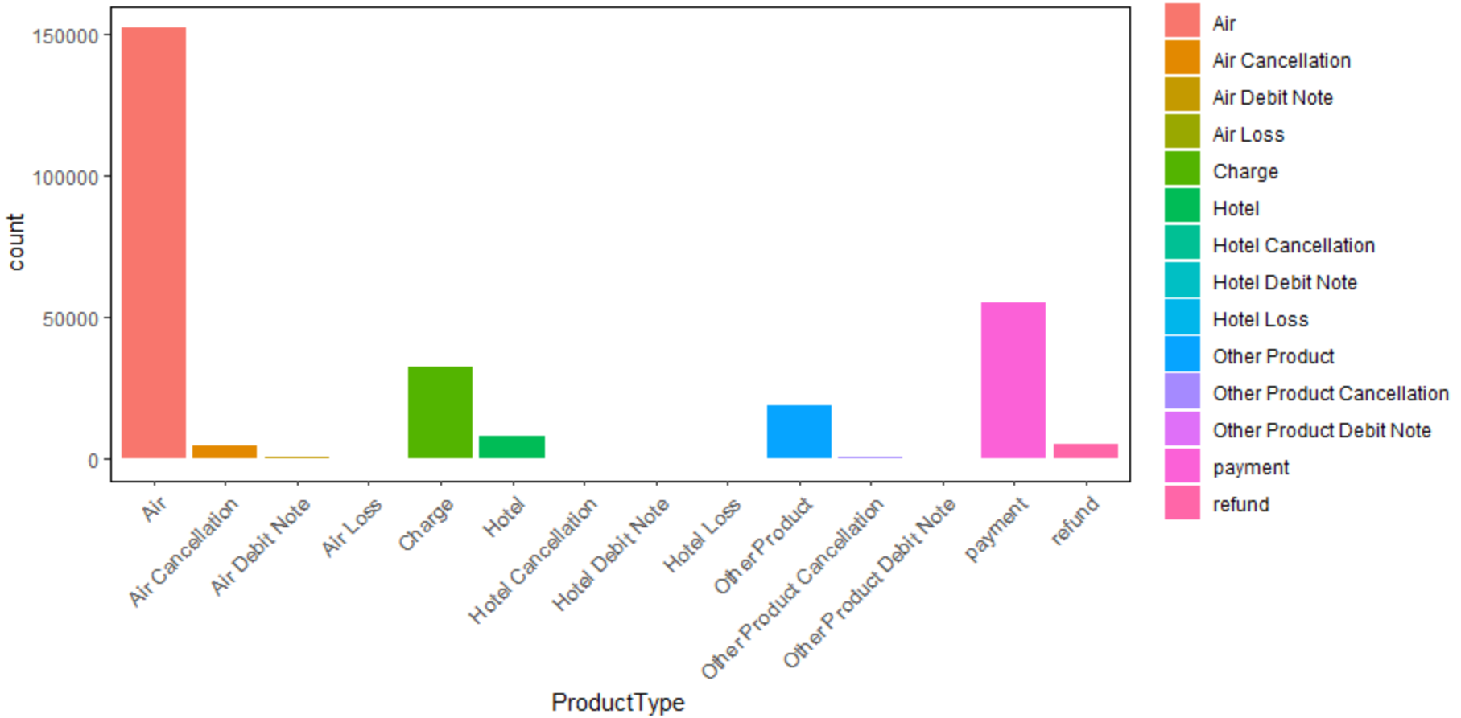
EXPLORATORY DATA ANALYSIS
Data distribution based on count of Product Type

Slide 7
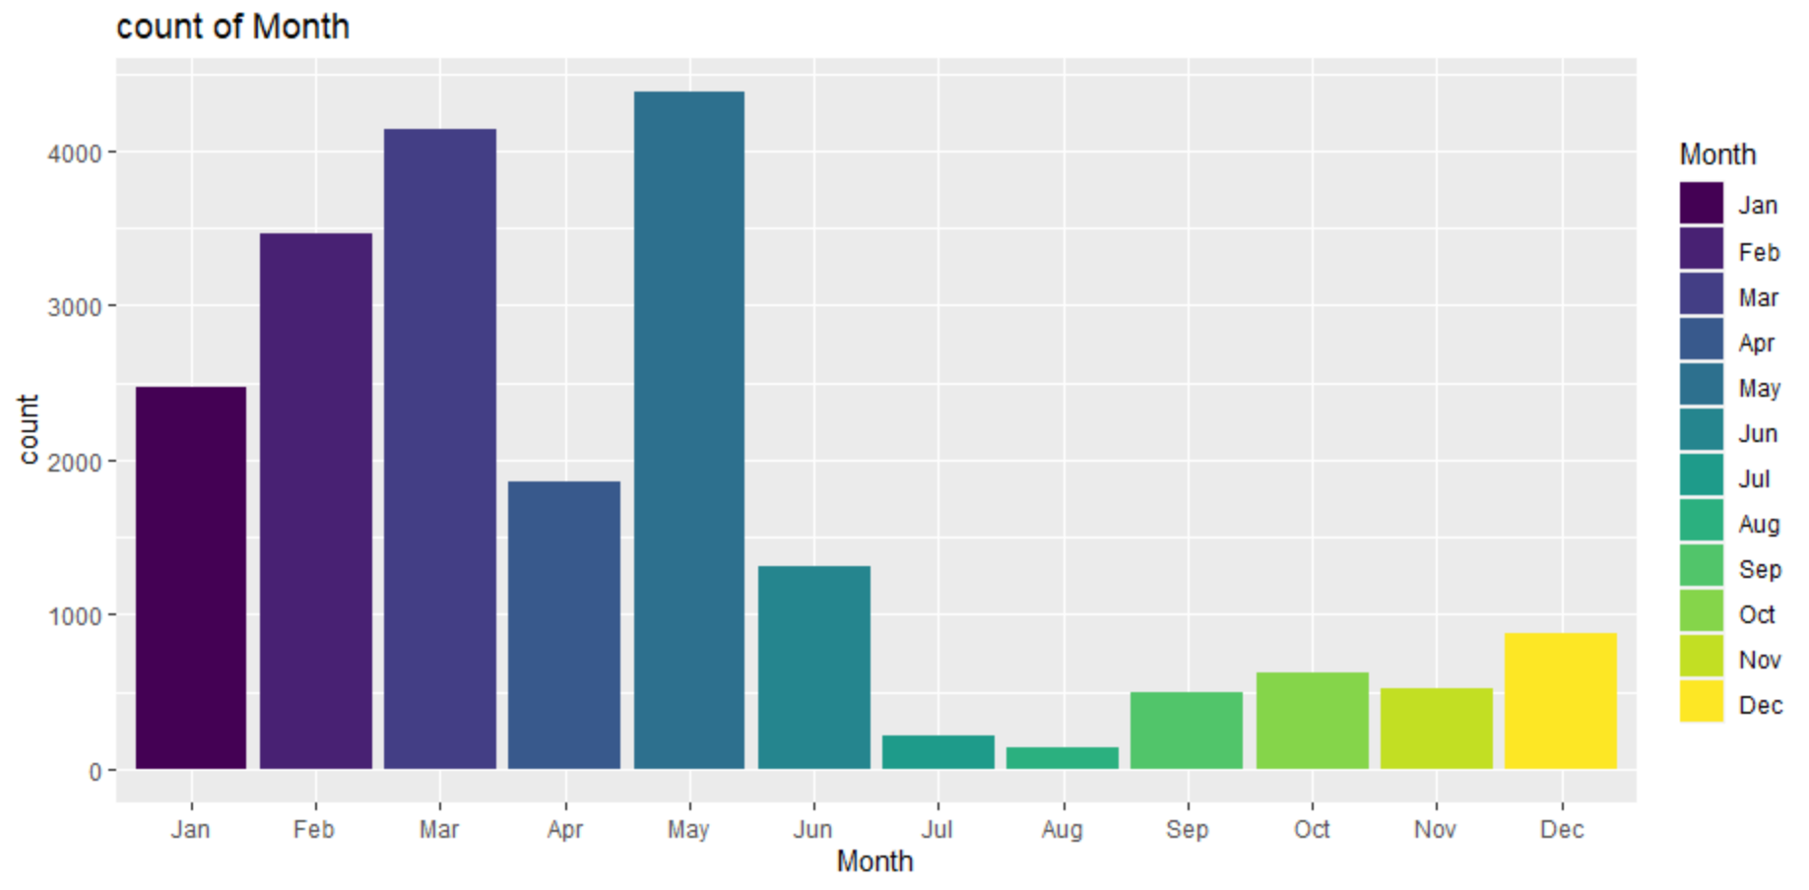
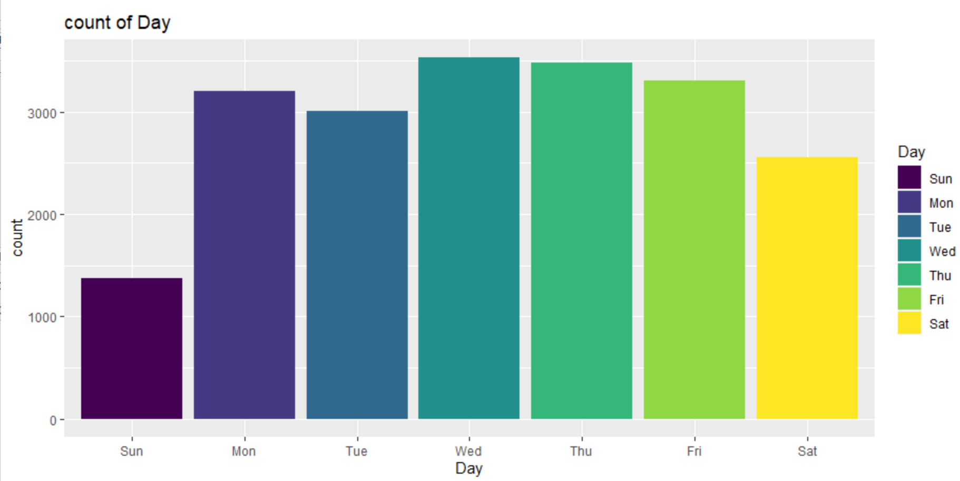
EXPLORATORY DATA ANALYSIS
Data distribution based on ‘Month’ and ‘Day’

Slide 8
PRE-PROCESSING OF THE DATA
Air Fare prediction
The variable Invoice Date contains 2 missing values.
The variable Net Fare contain 60891 missing Values.
The variable Product Type contains 2 missing values.
The variable Itinerary Type contains 32777 missing values.
Imputing the missing values to variables with Mean/Mode for the above mentioned variables.

Slide 9
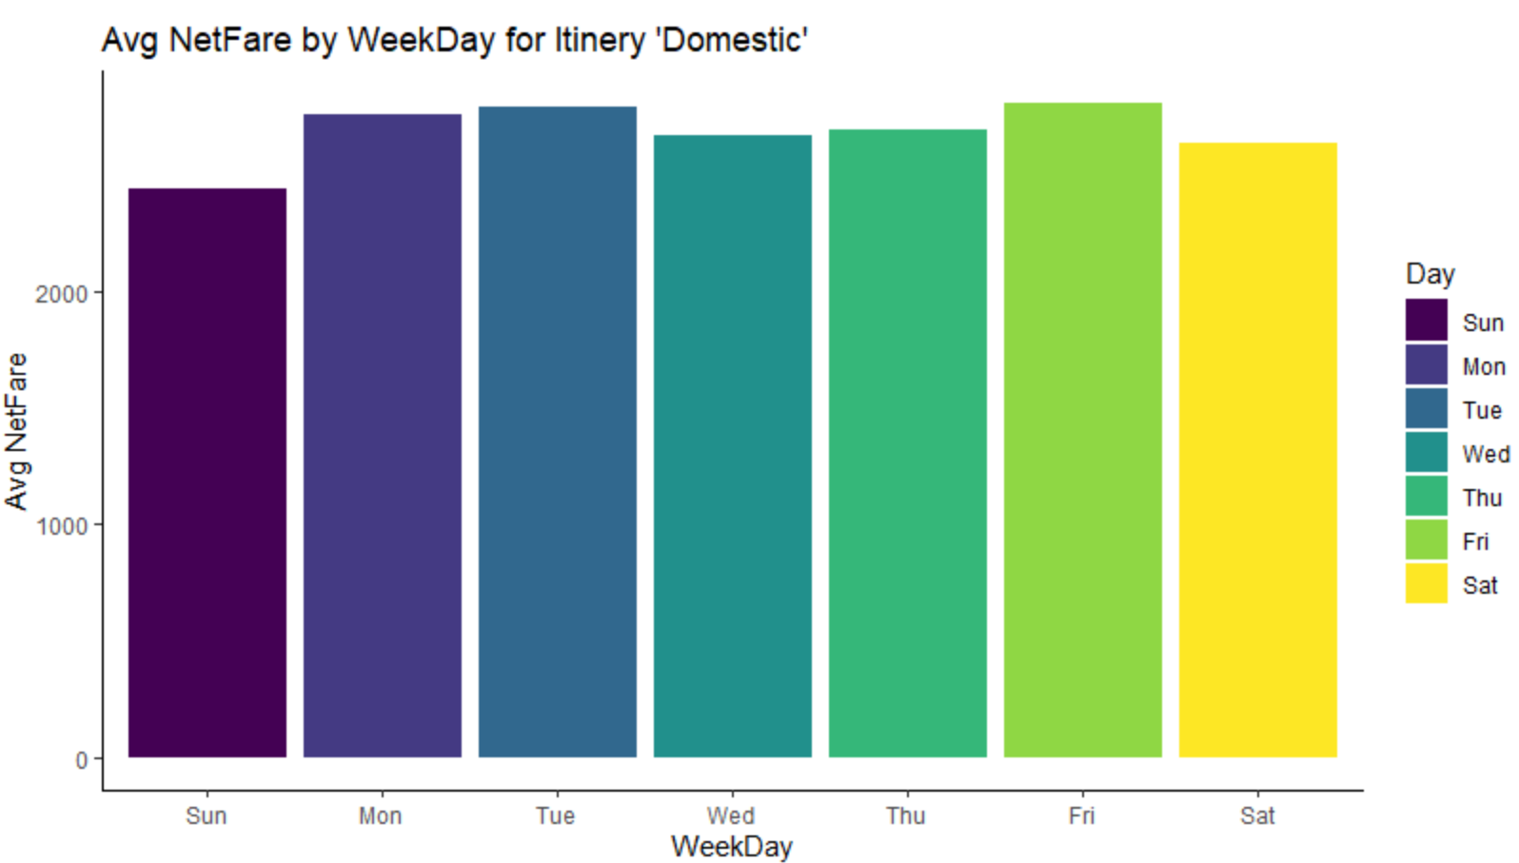
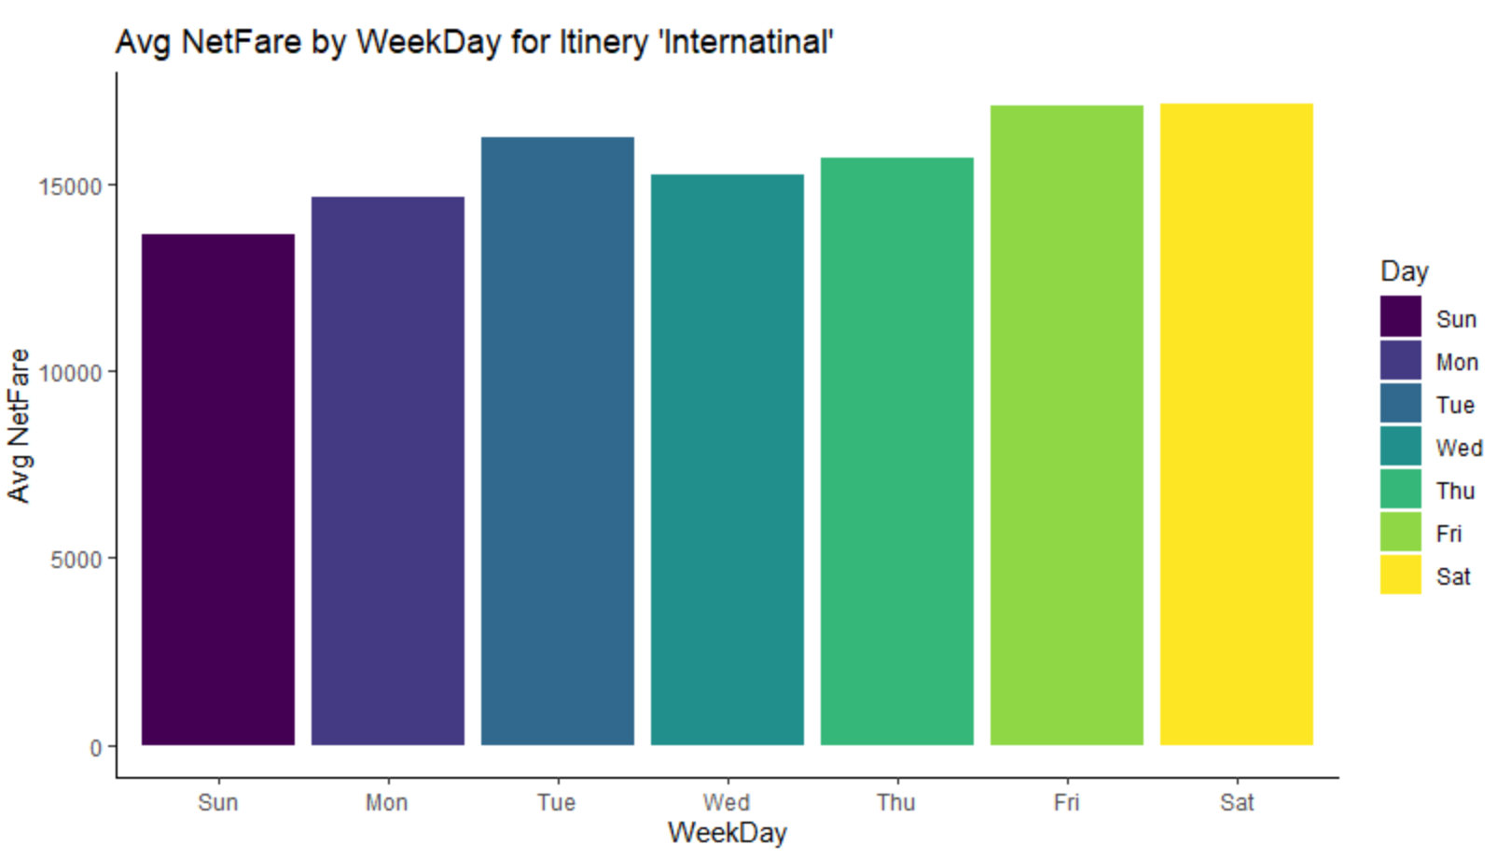
Preprocessed data for domestic and International Travel
Data distribution-Avg Net fare by week for ‘Domestic’ and ‘International’

Slide 10



Top-3 Model
Itinerary Type | RMSE
Domestic | 284.58
International | 8626.25
ARIMA
Itinerary Type | RMSE
Domestic | 4356.75
International | 9564.54
Neural-Network Forecast
Itinerary Type | RMSE
Domestic | 725.38
International | 9472.17
FACEBOOK PROPHET

Slide 11
Other Models tried
MODELS | Domestic-RMSE | International-RMSE
Multi Liner Regression | 805.799 | 24024
Decision Tree | 778.1242 | 796.832
Random Forest | 719.4535 | 459.95
Simple Exponential Smoothing | 7800.64 | 10457.54
Holt’s | 11456 | 12456

Slide 12

Project Challenges
Dealing With Missing Values for the variables Invoice date, Net Fare, Product Type and Itinerary Type.
Confusion in Choosing Correct Imputation Techniques.
We Have Tried Various Techniques Like “MLR, Random Forest, Decision Tree, XGBoost, Exponential Smoothing Method, Holts Method, Neural Network Method, Naïve Method, Arima Method, TBATS method, Prophet Method” to Calculate Least RMSE.

Slide 13
Overcoming Challenges
Air Fare prediction
To Overcome Missing Values Challenges In Invoice Date Column We Used “MODE” Function, Similarly for Net Fare we used ‘Zero’ value for non significant Product Type (Payment and Refund), To fill the Product Type we used “MODE” and Itinerary Type with “MODE” Which were Not Present.
After Trying All Methods Of Model Building We Came to Conclusion Of Selecting “ARIMA” Model, As A Method Of Model Building. As We Got Least RMSE By Using This Model.

Slide 14
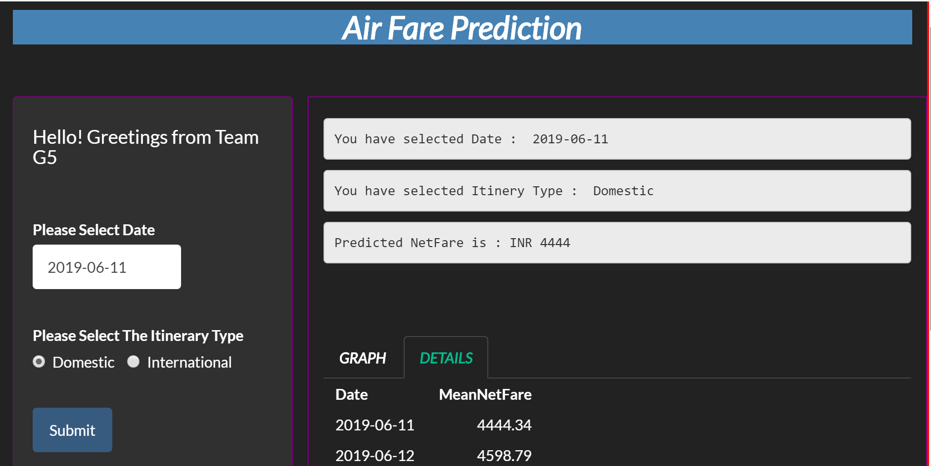
R-Shiny Model
Air Fare prediction

Slide 15

Thank you
By:
Amirtha varsini Priya. A
Anupama. N
BhagyaShrI SOMNATHE
Girish WARKE
Milind Shende

